Slide 1
RPA (UiPath) 1st Course – 10/10/2022
Adelina Staicu
nicoleta.staicu@unibuc.ro
http://mind-sherpa.net/
https://www.linkedin.com/in/adelina-nicoleta-staicu-8b1244104/

Slide 2
RPA Kickoff
To join, go to: ahaslides.com/2DR5Z

Slide 3


Types of robots
Attended bots
run under human supervision and, because of this, are best suited for use with smaller, more fragmented tasks;
human input is required at some point in the process
Unattended bot
are intended for more complex and highly repetitive tasks, usually needing to be performed in batches, that can be decided based upon a predefined rule;
additionally, unattended automations are suited to processes that perform privileged operations, requiring elevated permissions and credentials;
do not require human interaction.

Slide 4

What RPA can automate?
Rule based processes

Slide 5

What RPA can automate?
Rule based processes
Repetitive processes

Slide 6

What RPA can automate?
Rule based processes
Repetitive processes
Standardized input data

Slide 7

What RPA can automate?
Rule based processes
High volume processes
Repetitive processes
Standardized input data

Slide 8

What RPA can automate?
Rule based processes
High volume processes
Repetitive processes
Stable processes
Standardized input data

Slide 9
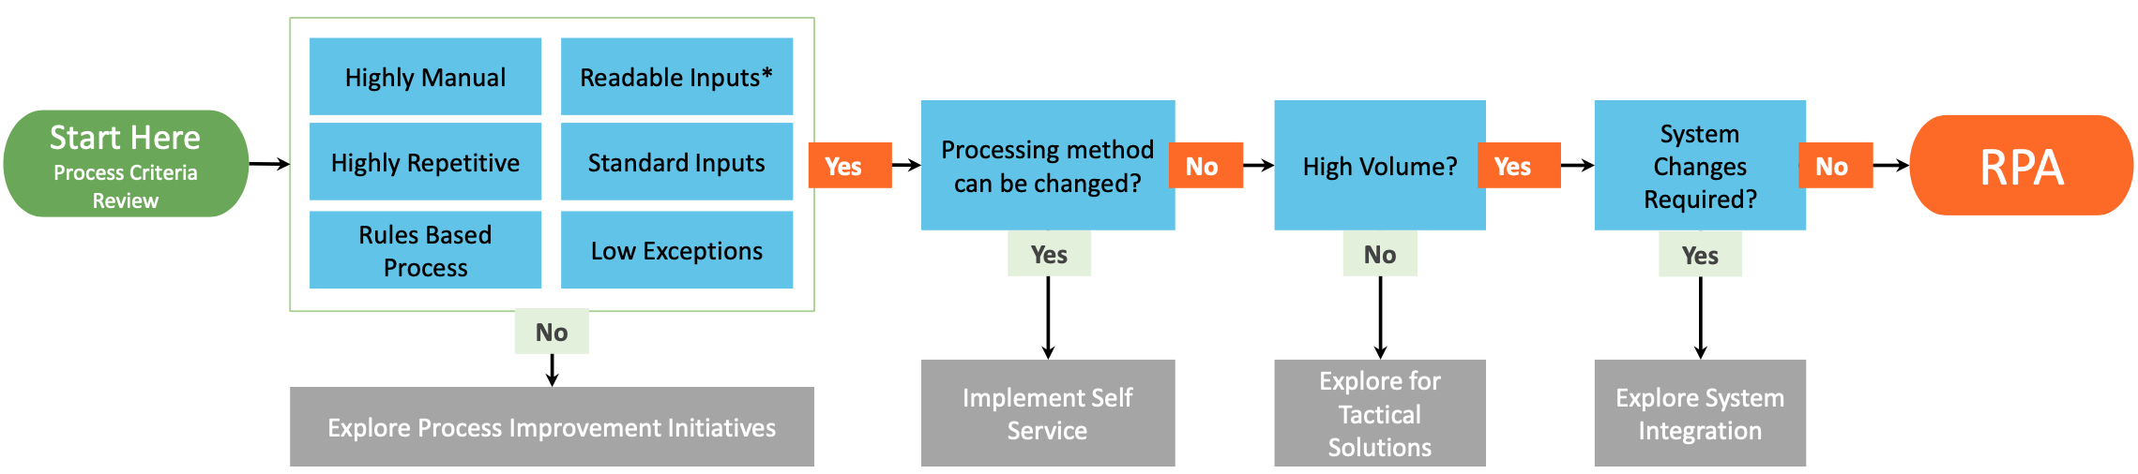
Identify a process that qualifies to the below criteria / characteristics:
Evaluating alternative solutions:
e.g. organizational, sequential improvement
e.g. configurable change of options
e.g. can tasks be assigned differently
e.g. enhancing system functionality
Robotic Process Automation solution
1
2
3
*readable input type = excel, word, email, XML, PDFs etc.
Non-readable input type: scanned image with no OCR

Slide 10
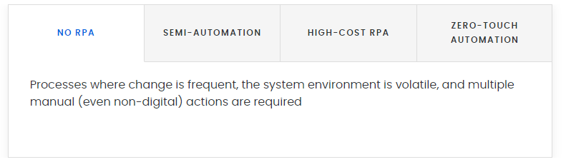
Automation Complexity

Slide 11
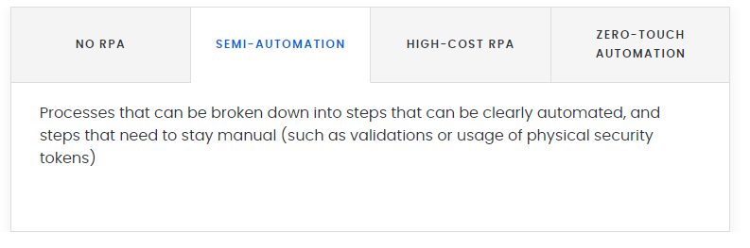
Automation Complexity

Slide 12
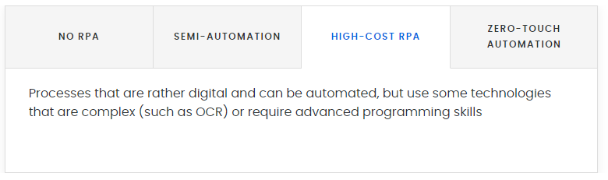
Automation Complexity

Slide 13
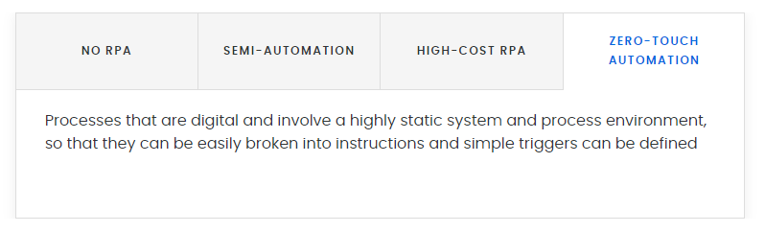
Automation Complexity

Slide 14
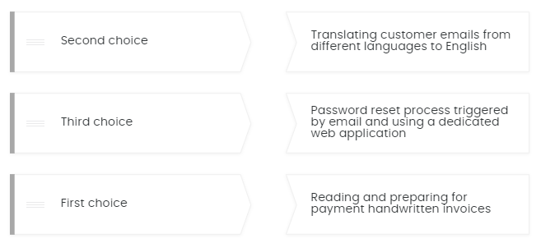
Consider the following 3 processes. What would be your first, second and third choice for automation from the point of view of effectiveness and efficiency (low effort and costs, high benefits)?

Slide 15
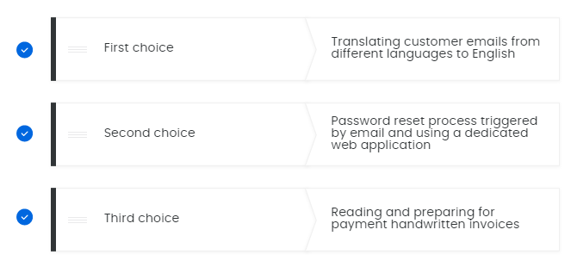
Consider the following 3 processes. What would be your first, second and third choice for automation from the point of view of effectiveness and efficiency (low effort and costs, high benefits)?

Slide 16
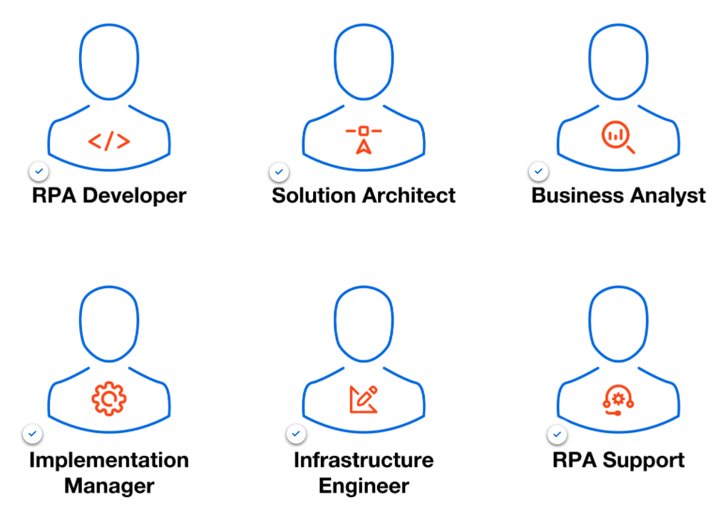
RPA Team

Slide 17
Process optimization
Organizations are faced every day with the challenge to produce more spending less. A suboptimal process will never deliver the most efficient result possible.
Identify
Think about a process in a company that is costing them more than it should or inducing client’s dissatisfaction or even stress between employees.
What is the final purpose of the process? What should the outcome be?
Where does the process start and ends?
What activities are part of the process, passing through the stages?
Which departments and people are involved?
Which information travels between steps?
At this point, we are asking what is the process, and not how to do it.

Slide 18
Process optimization
2. Rethink
It is the time to map the process, worrying about how to execute each step, about how the process flows, about what is process optimization to this process.
Is there a better way to perform this process?
How exactly is this process conducted?
How much paper (for example) does this process use?
How long does the process take to be finished?
How much time is lost in rework and mistake correction?
Where does the process stall?
Having a micro and macro vision is important. Each detail is important, since the way an email is written until the perception of what the client wants.
Compare the answers to this questions to the ones in the first item, and maybe you will find out that tasks that seemed crucial are expendable.

Slide 19
Process optimization
3. Automate
Automate the processes that are proved to work and spread them through the company to see the results in costs reduction, mistake prevention, wastage cut and production increase.
4. Monitor
Through the entire process optimization, monitor, monitor, and monitor. After the automation, you will sure find new improvement points and bottlenecks. Identify them, rethink the process, implement it and automate it.
As all the processes in business process management, this is a cyclical project.

Slide 20

RPA course evaluation
Based on a project (as a team (3-5 students))
The project aka The Robot built by you will be evaluated in the last week of school.
Checkpoint: 14th November (mandatory)– the students will send the robot proposal (in Teams or via Email) and check with the teacher if the idea meets the requirements.
Checkpoint: 12th January (optional)– the students will submit a first version of the robot (in Teams or via Email) in order to receive feedback from the teacher (feedback that is expected to be implemented until Evaluation Day)
Evaluation Day: every team will have a 15 minutes time slot to present the problem that the robot is solving, to show the robot in action and to answer the possible questions from the teacher and/or colleagues.
Project requirements: the grading scale can be found in Teams, Files section.

